Slide 1
Composite (recursive descent parsing) with Scala XML

Slide 2
XML

Slide 3
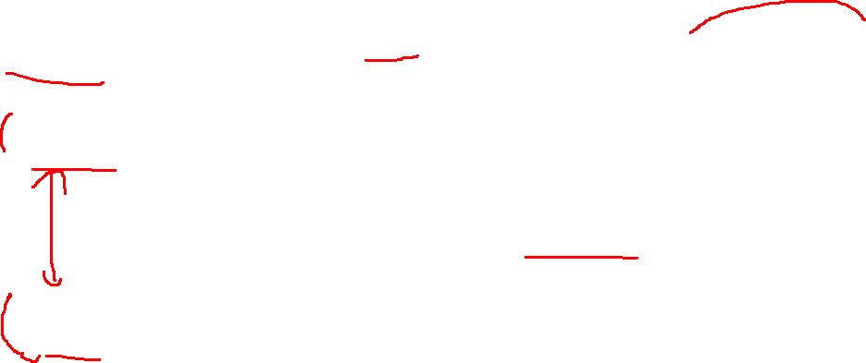
XML
Declaration
<?xml version="1.0" encoding="utf-8"?>
<pets>
<owner name=“Harold” />
<pet species="Cat">Patty</pet>
<pet species="Dog">Dog</pet>
</pets>
Tag not enclosing anything
Root tag (only one)
End tag
Text enclosed in tag
Start tag

Slide 4
XML
<?xml version="1.0" encoding="utf-8"?>
<pets>
<owner name=“Harold” />
<pet species="Cat">Patty</pet>
<pet species="Dog">Dog</pet>
</pets>
You can nest as deep as you want.
You can have as many attribute/value pairs as you want.
You can already start to see why these patterns are good for XML
Attribute
Value
Nice layout and indentation are not required!

Slide 5
Name spaces
<RelativeLayout xmlns:android="http://schemas.android.com/apk/res/android"
xmlns:tools="http://schemas.android.com/tools"
android:layout_width="match_parent"
android:layout_height="match_parent"
tools:context=".MyActivity" >
<TextView
android:id="@+id/myTextView"
android:layout_width="wrap_content"
android:layout_height="wrap_content"
android:layout_centerHorizontal="true"
android:layout_centerVertical="true"
android:text="@string/hello_world" />
</RelativeLayout>
Namespaces allow you to have names that are recognized and avoids name overlap issues.
SCALA calls these “prefixes”
android:text="@string/hello_world"

Slide 6
What about JSON?
{
"owner": "Harold",
"pets": [
{
"species": "Cat",
"name": "Patty"
},
{
"species": "Dog",
"name": "Snoopy"
}
]
}
JSON will have a VERY similar structure.
Seriously, 75% of the time you just change the call and library names
However, XML is used more heavily in GUIs, so this is prep for next semester

Slide 7
Scala

Slide 8
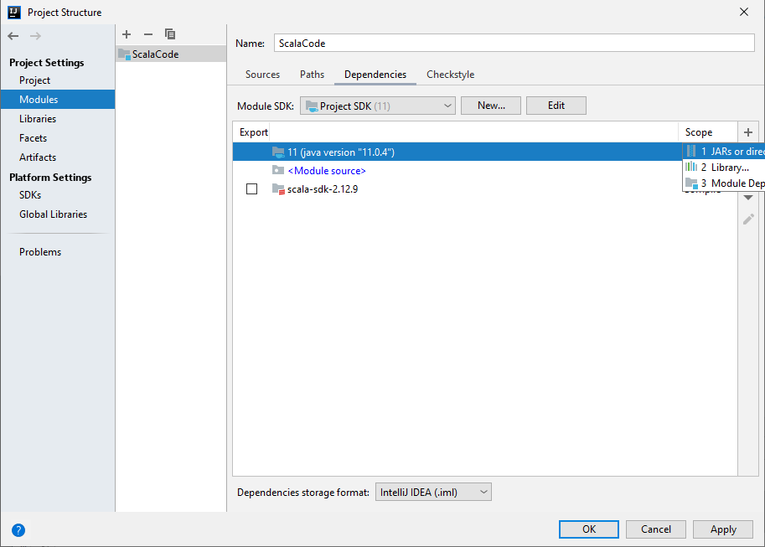

Writing XML
You need to add in the library dependency after Scala version ~2.10.
Instructions are in the install power point

Slide 9

There is a tremendous amount of BAD xml code for Scala on the internet (even the author of Scala regrets the original format). In fact, the “original” is GONE starting in 2.13. I’m presenting this mostly using the paradigms that are reusable across languages.

Slide 10
If you see this, you have the WRONG version
def createNode( value : String, content: String) : Elem = { val temp = <node key={value}>{content}</node> return temp }
pull immediate tags with \
val owners = pets \ "owner“
pull all descendent with \\
val allPets = pets \\ "pet“
Etc…
Writing it by hand is a ridiculously easy way to error on the syntax.

Slide 11
The right way!
As close to streaming as possible!!! Streaming is faster, and much better if your file size is >10KB.

Slide 12
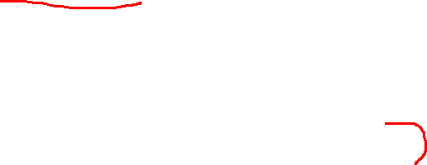
Core XML classes
Attributes
The MetaData abstract class holds the attributes of the node.
The BIG one to know is UnprefixedAttribute
Normal key->value attribute
Very much functional in usage.
Example:
new UnprefixedAttribute(“key",
“value",
moreMetaData)

Slide 13
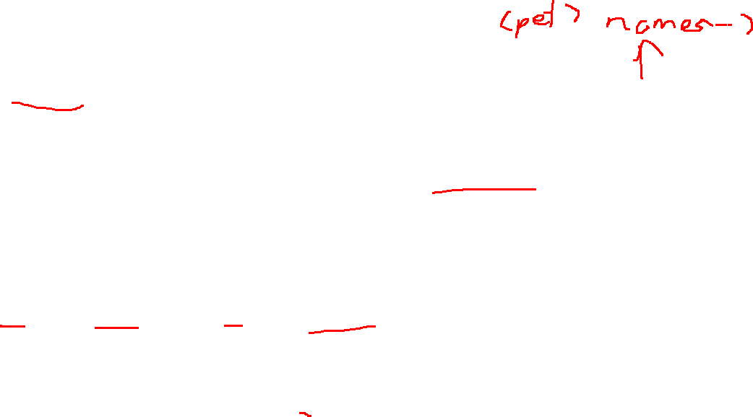
Core XML classes
Leaf Node
Text is a Node with text rather than more tags
This is still needed for an empty tag
Examples:
//make leaf
val child: Node = Text("Stuff")
//make empty tag
val child: Node = Text("")

Slide 14

Core XML classes
Node
The Elem class, with everything required
Making it from a constructor is a pain
Elem(
prefix,
tag,
key-value attribute pairs (MetaData),
namespace,
compact,
children)

Slide 15
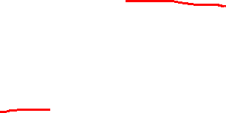
Making it…
I made a helper class to solve this
It uses the factory pattern!
XMLHelper:
Is class of only static functions
You give it the
Tag
Attribute
Child(ren)
It will do the rest and make a Node

Slide 16
The calls
Options
tag with no attribute or children
val newNode = XMLHelper.makeNode(“tag")
tag with attributes, but no children
val newNode = XMLHelper.makeNode(“tag", attributeMap)
tag with no attribute, with a child
val newNode = XMLHelper.makeNode(“tag", null, child)

Slide 17
The calls
Options (cont)
tag with attribute and a child
val newNode = XMLHelper.makeNode(“tag", attributeMap, child)
tag with no attributes, but with children
val newNode = XMLHelper.makeNode(“tag", null, children)
tag with attributes and children
val newNode = XMLHelper.makeNode(“tag", attributeMap, children)

Slide 18
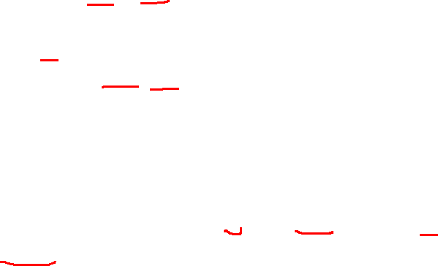
Scala XML basic Node functions
I can pull children with .child
val children = pets.child
I can pull the tag name with .label
println("Tag:" + child.label)
I can pull ALL attributes with .attributes
child.attributes
I can pull Text from ALL descends with .text (Proper xml should only have text in a leaf)
child.text
I can pull a specific attribute (returned in an Option) with attribute(key)
child.attribute(key)
BasicXML.scala

Slide 19
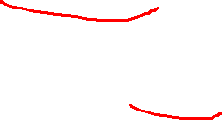
Option?
A return type of Option[dataType]
Wraps a possible null value.
This says if it is not null, grab it, otherwise, use a default value
val x = option.getOrElse(default)

Slide 20
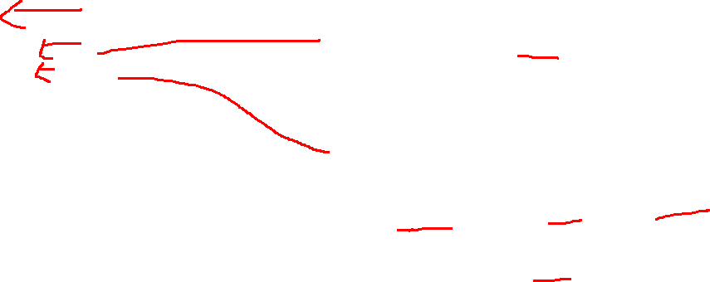
Roadmap: pseduocode
Reading pattern
Writing (build) pattern
read(n : Node)
grab attributes
for each child
if a tag we care about
append c.read( child )
Write ()
grab attributes
outXML =[]
//use map in SCALA
for each child
outXML += child.write()
return new node built
with outXML
Aside: this is for FUNCTIONAL paradigms, and the read ideally should be in a constructor! Imperative’s write() will take in the parent node (p) parameter, and will make the current node (c) at the top of the function, c adds its attributes, c attach itself to p, and then c forwards itself to its children.

Slide 21
To XML with classes
Small example

Slide 22
Basic class
case class Pet() {
private var species : String = _
private var name : String = _
def loadXml(node: Node): Unit ={
}
}
class Pets( ) {
private var pets : ListBuffer[Pet] = _
private var owner : String = _
def loadXml(node: Node): Unit ={
}
object Pets{
def apply(): Pets = {
val temp = new Pets()
temp.pets = ListBuffer[Pet]()
temp
}
}
I’m shrinking this back down to one owner for simplicity
<?xml version="1.0" encoding="UTF-8"?>
<pets>
<owner name="Harold"/>
<pet species="Cat">Patty</pet>
<pet species="Dog">Snoopy</pet>
</pets>
ChainXML.scala
Not an exact match to sample code

Slide 23
Start up the read from the top!
def loadXml(name : String) : Pets = {
var owner: Pets = Pets() //make composite root
val topNode = XML.loadFile(name) //get first node
if(topNode.label != "pets") { //confirm correct XML subtype
println("invalid xml file")
}else {
owner.loadXml(topNode) //start loading
}
return owner
}
val owner = loadXml("pets.xml") //call

Slide 24
Start Parsing (from owner.loadXMl()
def loadXml(node: Node): Unit ={
//if we had it, grab the attributes
val attr = node.attribute(“attr1") .getOrElse("").toString
val children = node.child //get children
children.foreach(child => //check each child
{
var tag = child.label //what type of node
if(tag == "owner") { //find matching node, and let it load itself
println(“have owner”)
}else if(tag == "pet"){
println(“have pet”)
}
}
Create a function for each child tag.
REPEAT for each level!!!!

Slide 25
Are all cases safe?
<pet species=“Cat”></pet>
<pet species=“Cat”>Patty</pet>
<pet species=“Cat”><something></something></pet>
<pet species=“Cat” doNotCare=“nope”> </pet>

Slide 26
Writing?
Scala made reading, VERY easy
But they focused so much on it, they made writing painful
Even the creator of Scala regrets it
Reminder: you will see a tremendous amount of BAD XML writing code online

Slide 27
Read’s write counterparts
Read
Write
Initial loadXML()
val newPets = owner.writeXml()

Slide 28
Read’s write counterparts
def writeXml(): Elem = {
//make attribute list val attr: mutable.HashMap[String, String]
= mutable.HashMap(("species", species))
//make text part if needed val text = Text(name)
//make the node return XMLHelper.makeNode("pet", attr, text) }
Read
Load in leaf class
←Write

Slide 29
Read’s write counterparts
def writeXml(): Elem = {
//grab attributes val attr: mutable.HashMap[String,String]
= mutable.HashMap(("name", owner))
//run xmlWrite for each child
// with map when appliable var petXml = pets.map(x => x.writeXml()) var ownerXml = XMLHelper.makeNode("owner",
attr)
//make merge children val children = ownerXml ++ petXml
//make the node with the children and attributes XMLHelper.makeNode("pets", null, children) }
Read
Load in normal class
←Write

Slide 30
Best practice
Best practice has all the tags as constant strings to avoid mistyping
The way presented has very little “copy and toss” that many other option have
I could have used the +: type operators to add in a new element, BUT
That shifts the datatype to NodeSeq (this is NOT Seq[Node])
I still need to make the Elem…at that point I might as well fully utilize the function
Have a function for loading each class
To meet the pattern, I MUST have a trait (interface) with loadXML and writeXML for each class
Sample code does this

Slide 31
Main parts: Top level class
This is the declaration and save
XML.save("anotherPet.xml", temp, "UTF-8", true, null)
The meaning in order:
file name
xml tree
Encoding
add the top declaration
add more documentation

